Slide 1
Zoom ASL
Team FortKnights
Convert ASL from Webcam Video to Text – Text to Speech – Speech Transcription
Mindspark ’22 | GRIDS

Slide 2
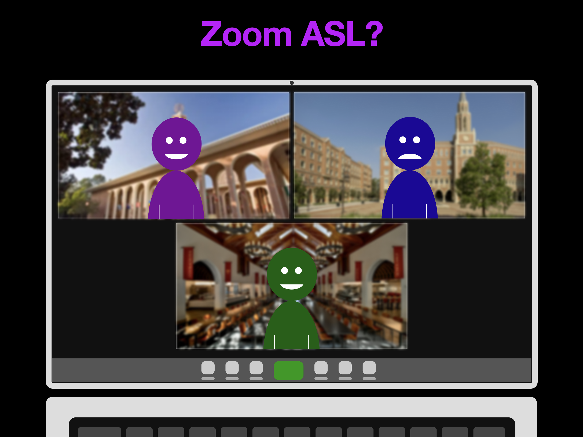
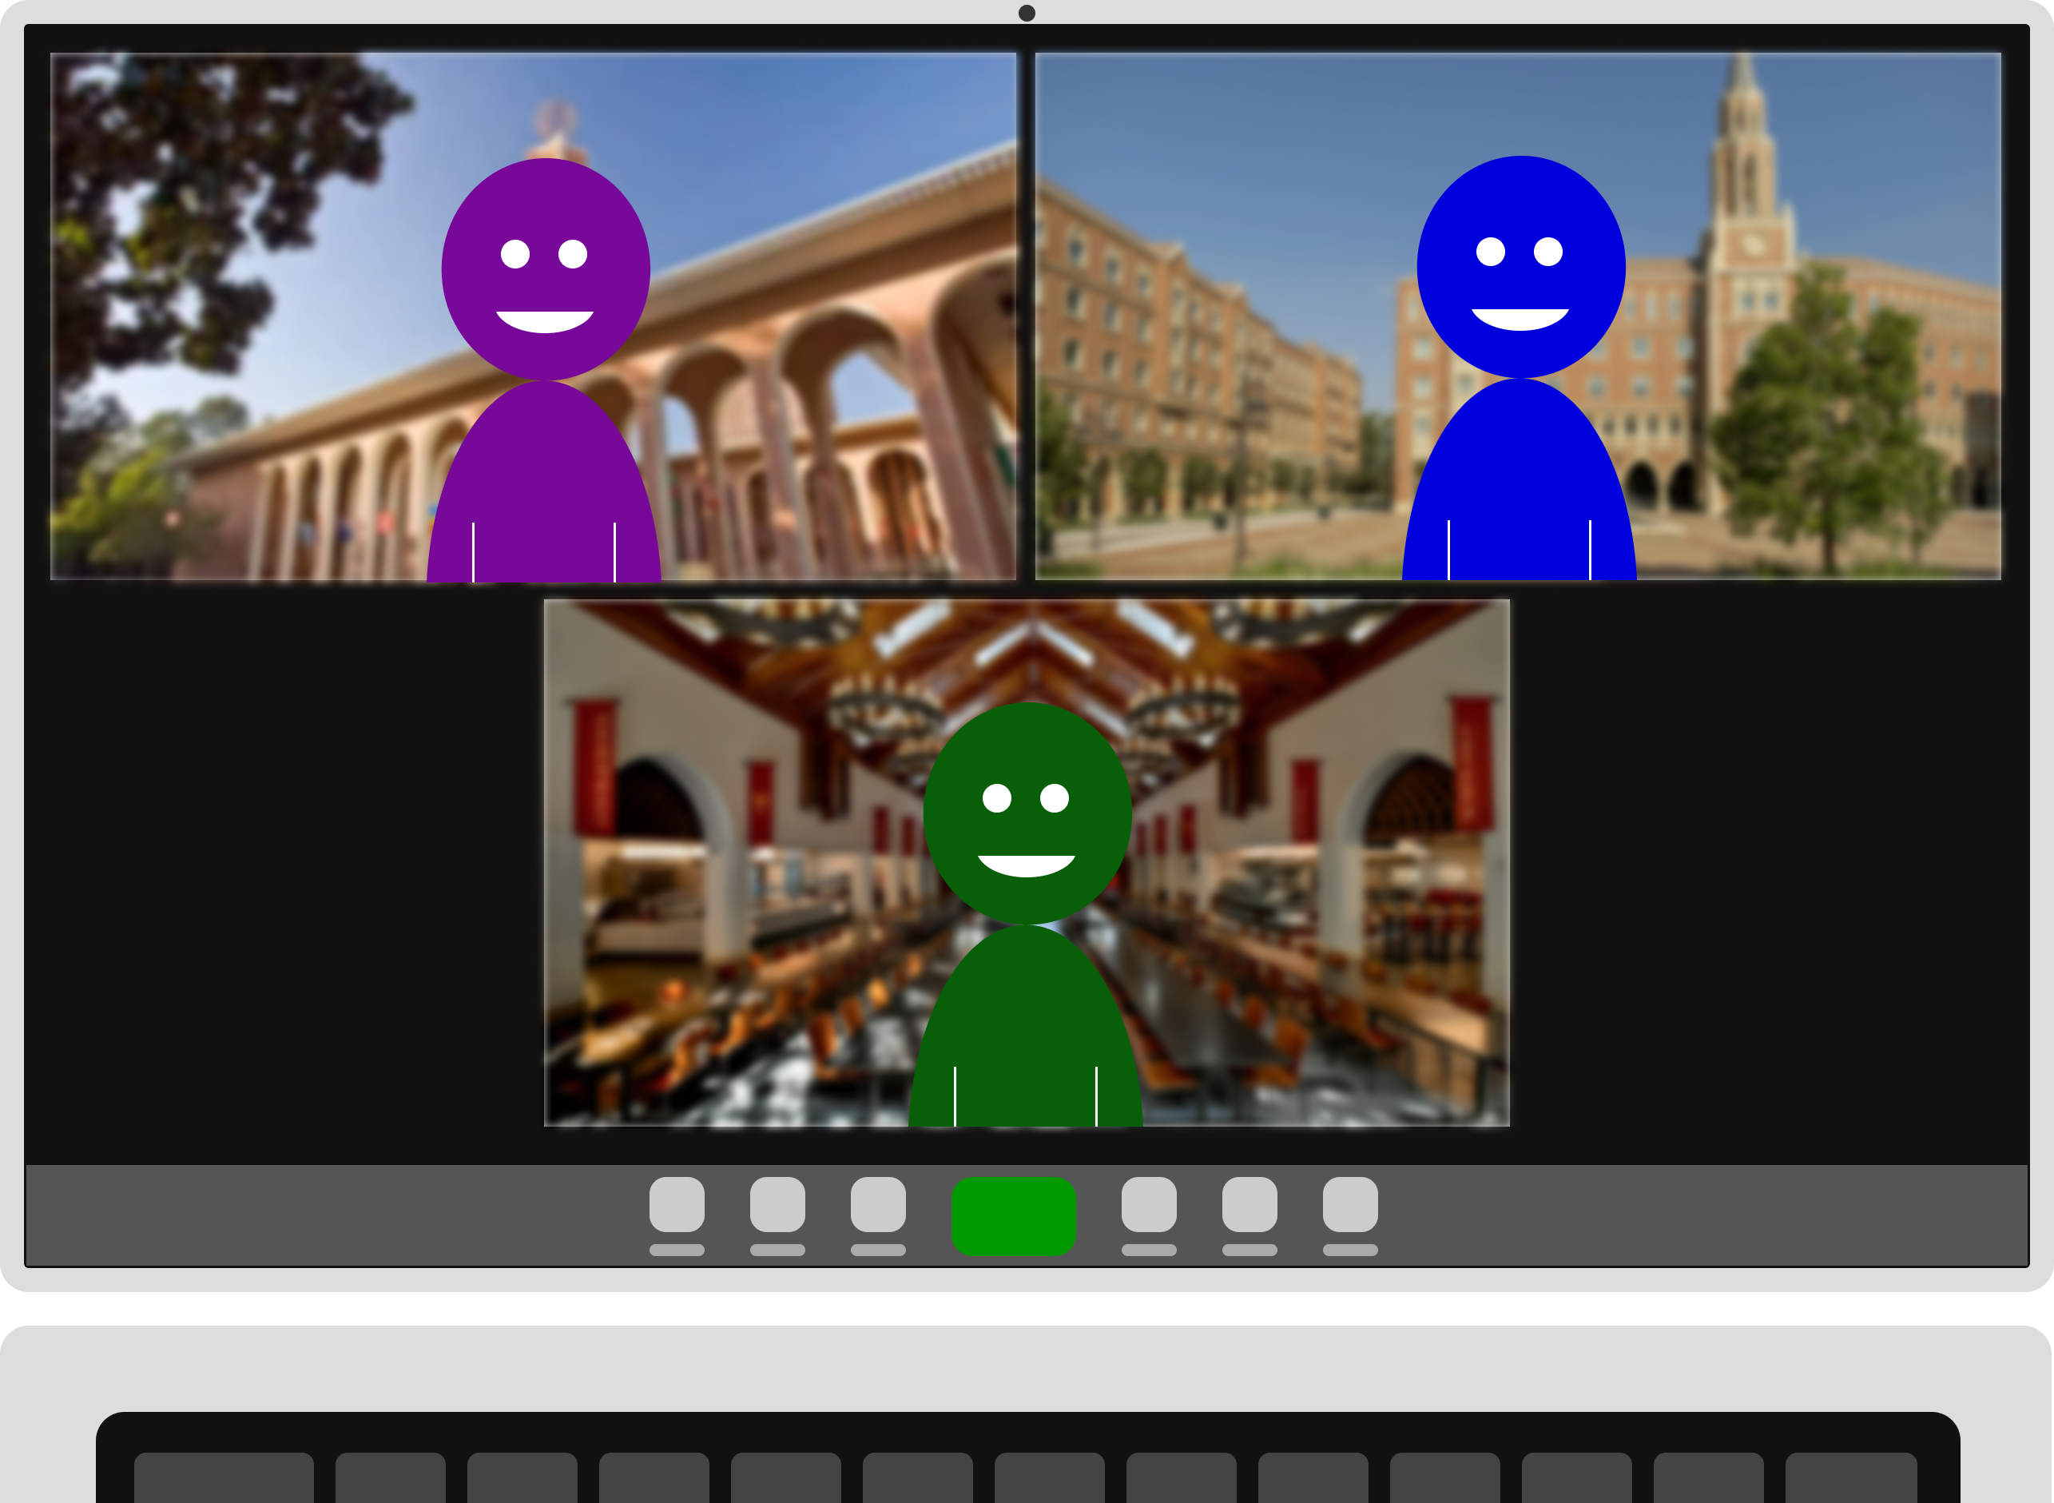
Zoom ASL?

Slide 3
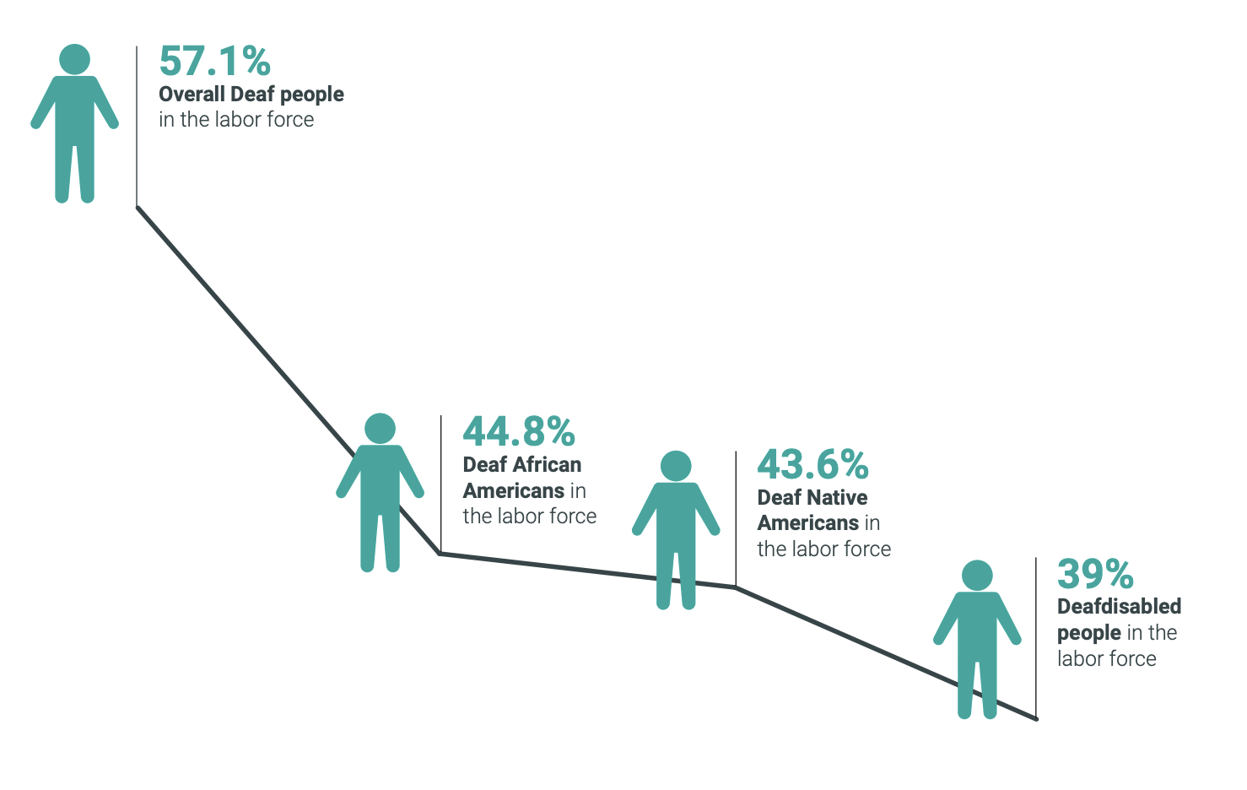
What do we have today?
57.1% of deaf people were employed in 2019^{[1]}
Closed captions or Communication Access Real-Time Transcriber for Deaf and Hard-of-Hearing
Pin and Spotlight to place a sign language interpreter alongside the presenter.
“On my team, I'm the only deaf employee,” said Adams. “Now that we are working remotely, I have an interpreter who can be available for scheduled meetings. If something is last minute and I don't have access to an interpreter, I will use the auto caption feature to help me keep up with the conversation, then I'll follow up if there's anything I need to clarify.” ^{[2]}
Fig: Percentage of Deaf People in the Workforce in 2019
¹ NDC, Deaf People and Employment in the United States: 2019 ² https://www.nationaldeafcenter.org/news/deaf-work-during-pandemic-making-gains-flexibility-optimism-and-resilience

Slide 4
Framework
Pose Detection + Palm Landmark detection:
Trained with WLASL (Word-level ASL) 100 Class (Scalable to 1000*) processed dataset. Data pipeline flows from Pose detection output, mapping skeleton point locations as a unique signature for glossary of signs
Convolutional Neural Network (MS-ALS): Spatial data load, Temporal Load (Optic Flow Computer Vision Library), and Fusion Model.
Trained with custom captured Sign language data for 6 classes (Short video clips).
ML-API for Speech to Text and Text to speech to facilitate end to end User Experience for the application
NLP based pre-trained framework to generate sentences based on sign language keywords
Efficient Streaming solutions to establish Video Endpoints using webcams through local Sockets and Web Sockets.

Slide 5
Word-Level American Sign Language Dataset
Roadblock Faced #1
Roadblock Faced #2
Large Number of Classes (2000) and in total 25000+ Videos of 4-5s each @24-30fps
Training Deep CNN and Optimizing is too complex
Videos Path were deprecated and creating a scraper using Youtube-dl didn’t work efficiently to generate required data even for 5 datapoints for 10 classes
Pre-trained models were not available for use for customization and tuning. Preprocessed OpenPose-ASL data was available
Custom Dataset was recorded during the hackathon for 6 Subjects for 6 Different Sign Gestures
Course Correction 1
Course Correction 2
Use Preprocessed Feature data to Train Sign Language translator Transformer Network for 100 Classes. Include a pretrained Sentence Generator in the pipeline to get whole sentences from predicted keywords from signs
Train CNN Framework with Optic Flow Input across consecutive frames for Temporal Option and Individual frames for Spatial Option and a Fused model
Additional Feature to Process Text-Audio/ Audio-Text using Google API’s
Create Socket Pipelines to stream from Webcam Client to Server and Run Inference On Server End
Holistic Application end points for Zoom ASL
Hackathon Journey!

Slide 6
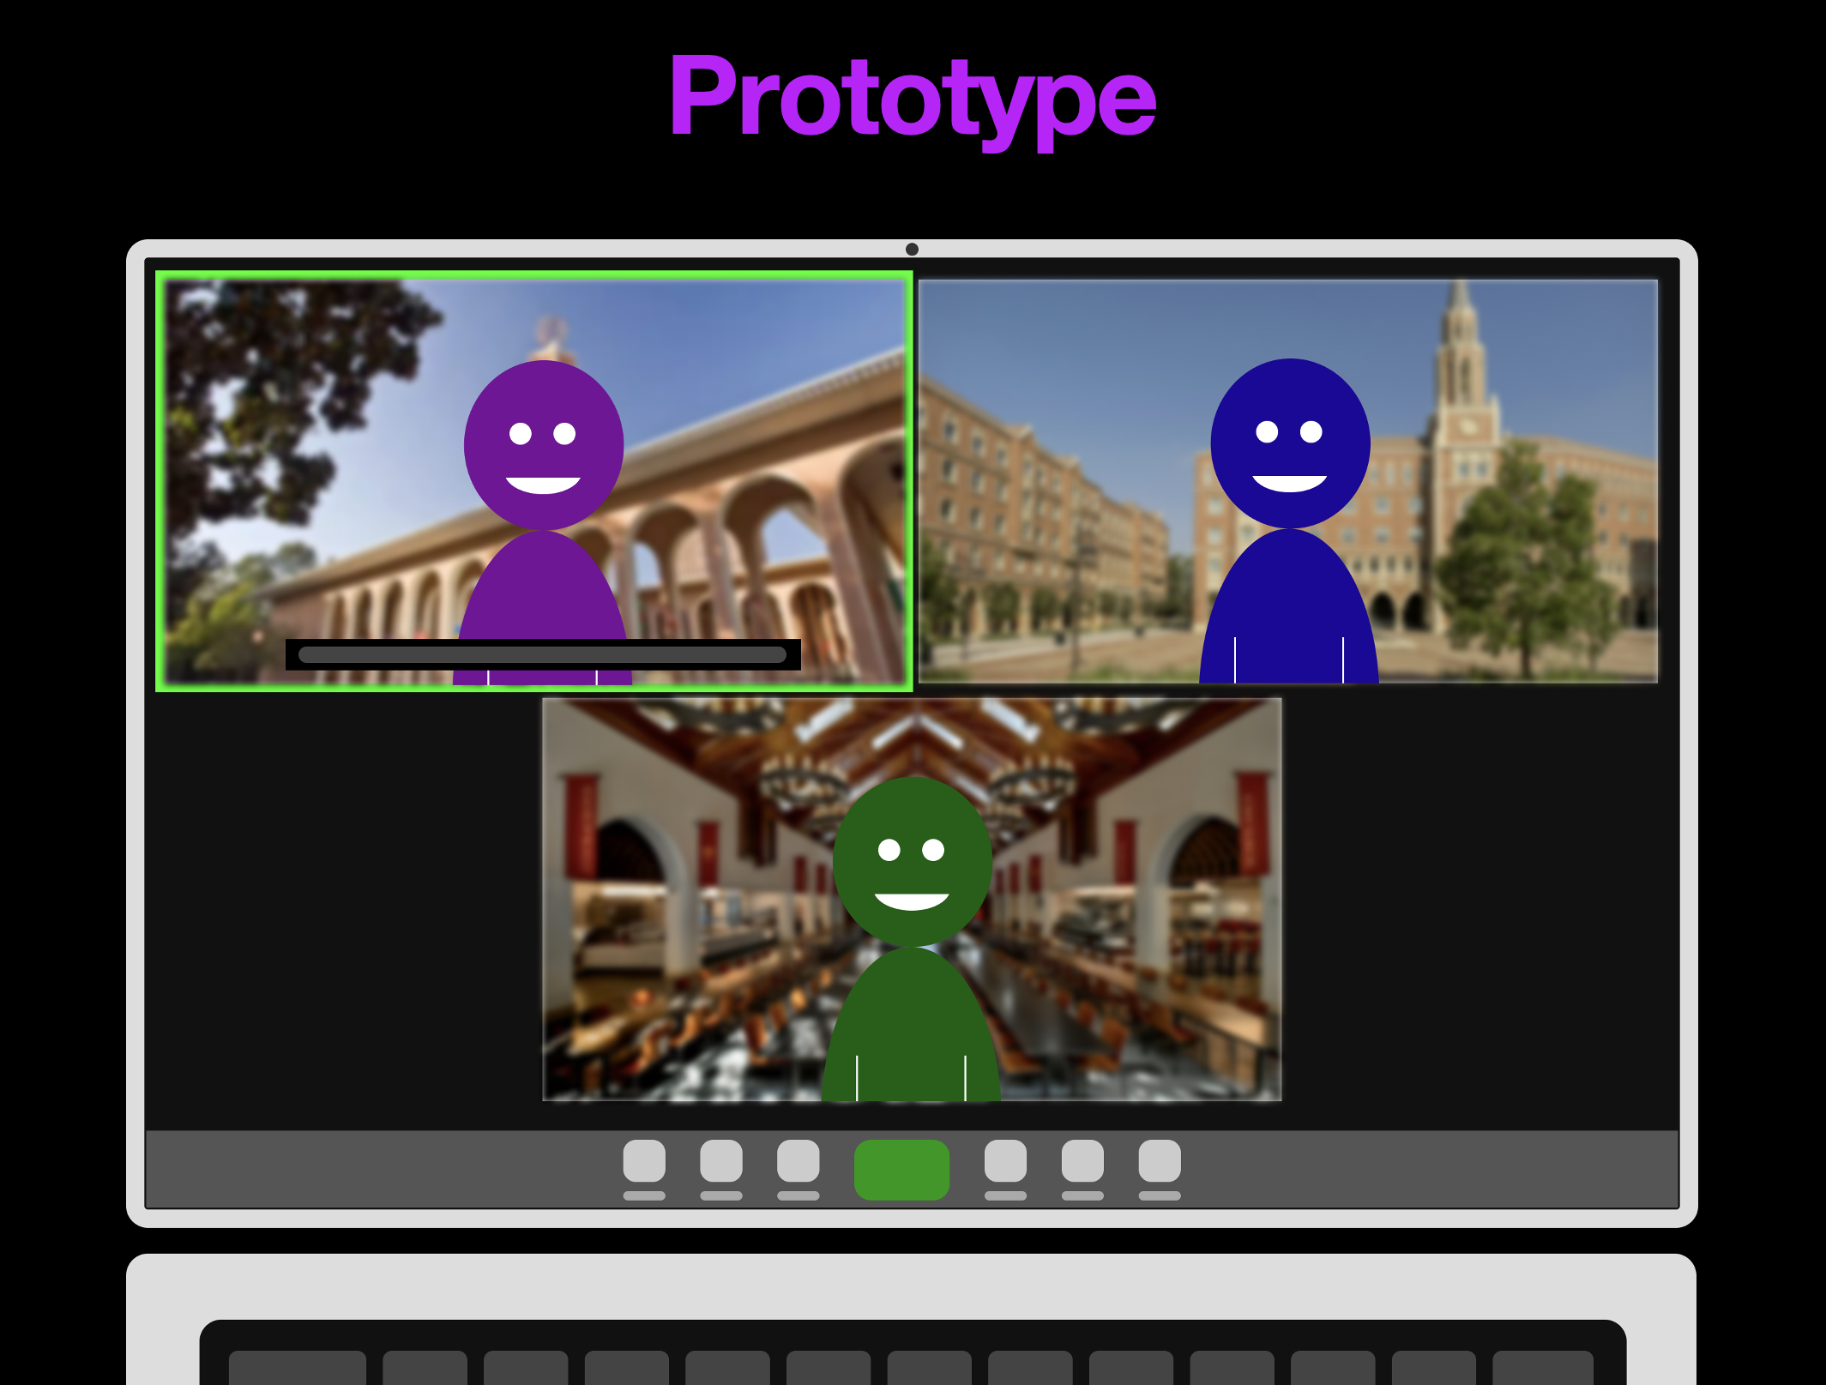
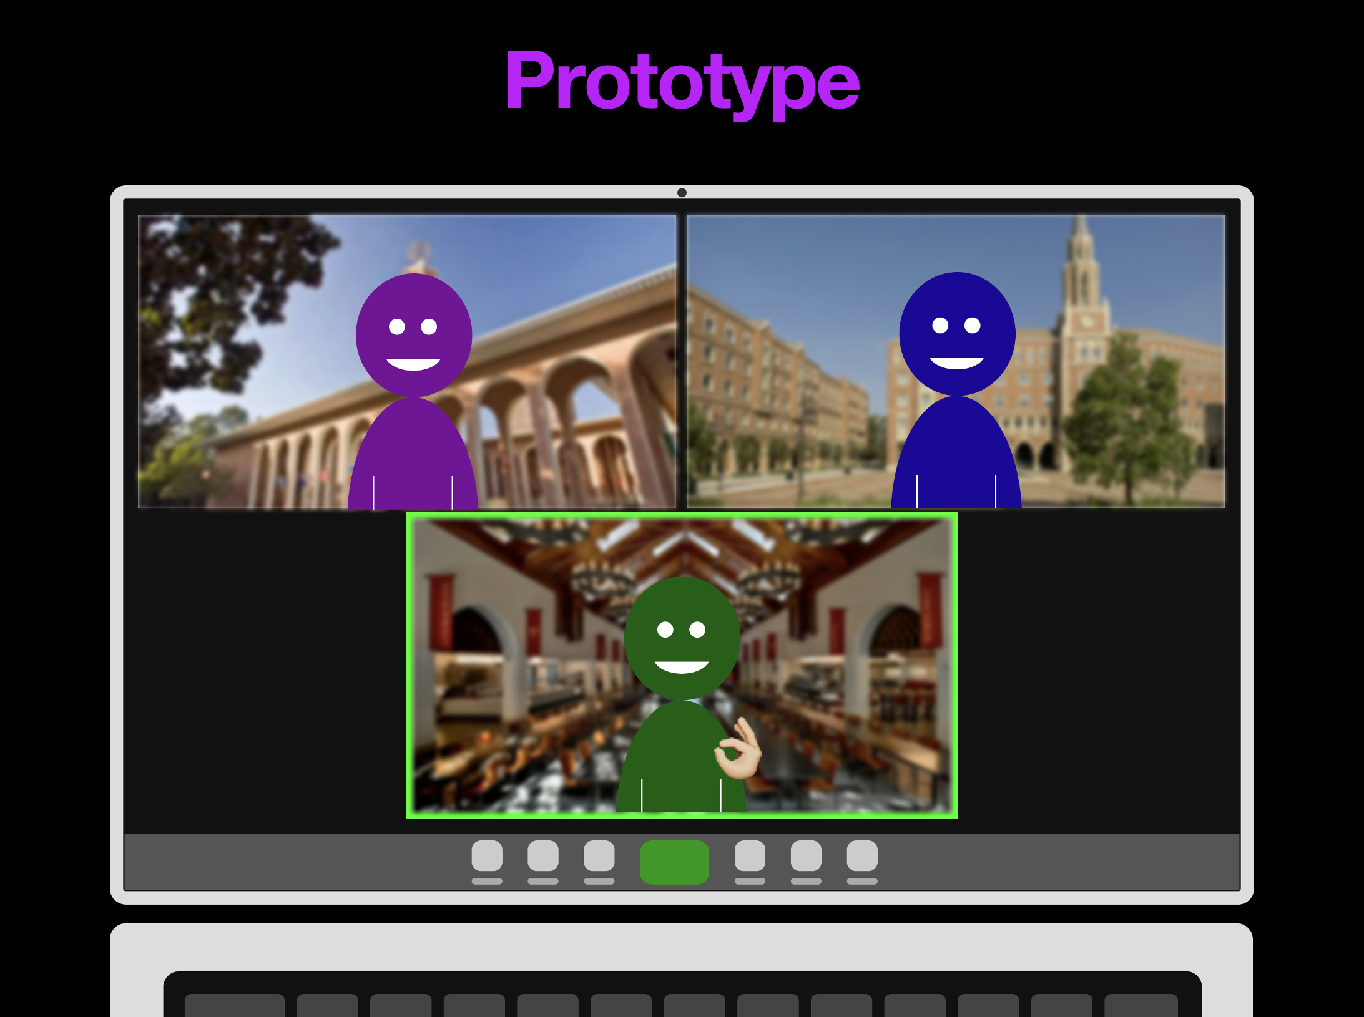
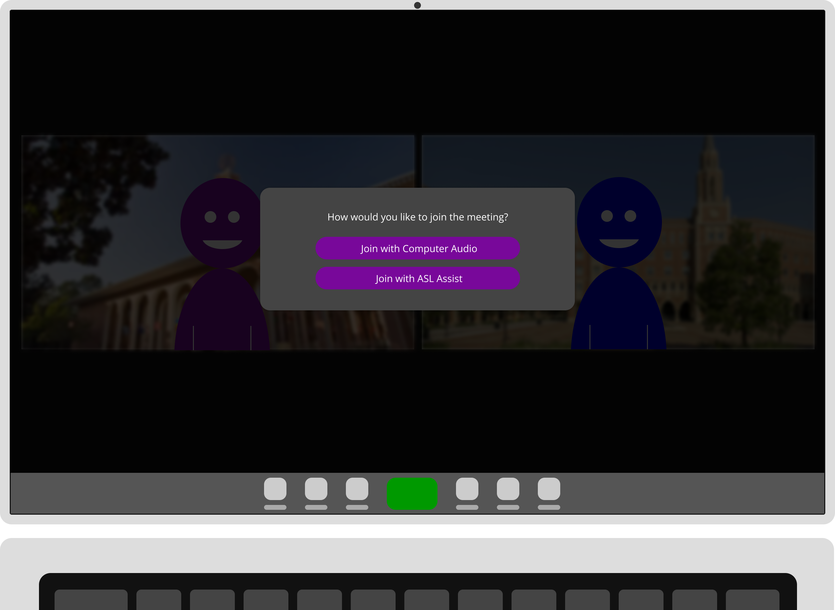
Ideal Prototype Wireframe

Slide 7
Demo

Slide 8
Thank You.
Team 14
Abhinaav Ramesh, Cibi Chakravarthy, Amal Jose, Piwat Wipahnuruat

Slide 9
References
Word-level Deep Sign Language Recognition from Video: A New Large-scale Dataset and Methods Comparison -Dongxu Li, Cristian Rodriguez Opazo, Xin Yu, Hongdong Li, https://arxiv.org/abs/1910.11006
MS-ASL: A Large-Scale Data Set and Benchmark for Understanding American Sign Language, Hamid Vaezi Joze, Oscar Koller, https://export.arxiv.org/pdf/1812.01053
Sign Pose-Based Transformer for Word-Level Sign Language Recognition, Matyáš Boháček, Marek Hrúz
https://google.github.io/mediapipe/
https://ai.googleblog.com/2020/02/exploring-transfer-learning-with-t5.html
https://fastapi.tiangolo.com/advanced/websockets/

